Slide 1

KloudMinds
Team: KloudCrew
Time: 19/07/2024

Slide 2

KloudMinds
an AI-driven cloud-native file management service
https://github.com/peacewang017/KloudMinds

Slide 3
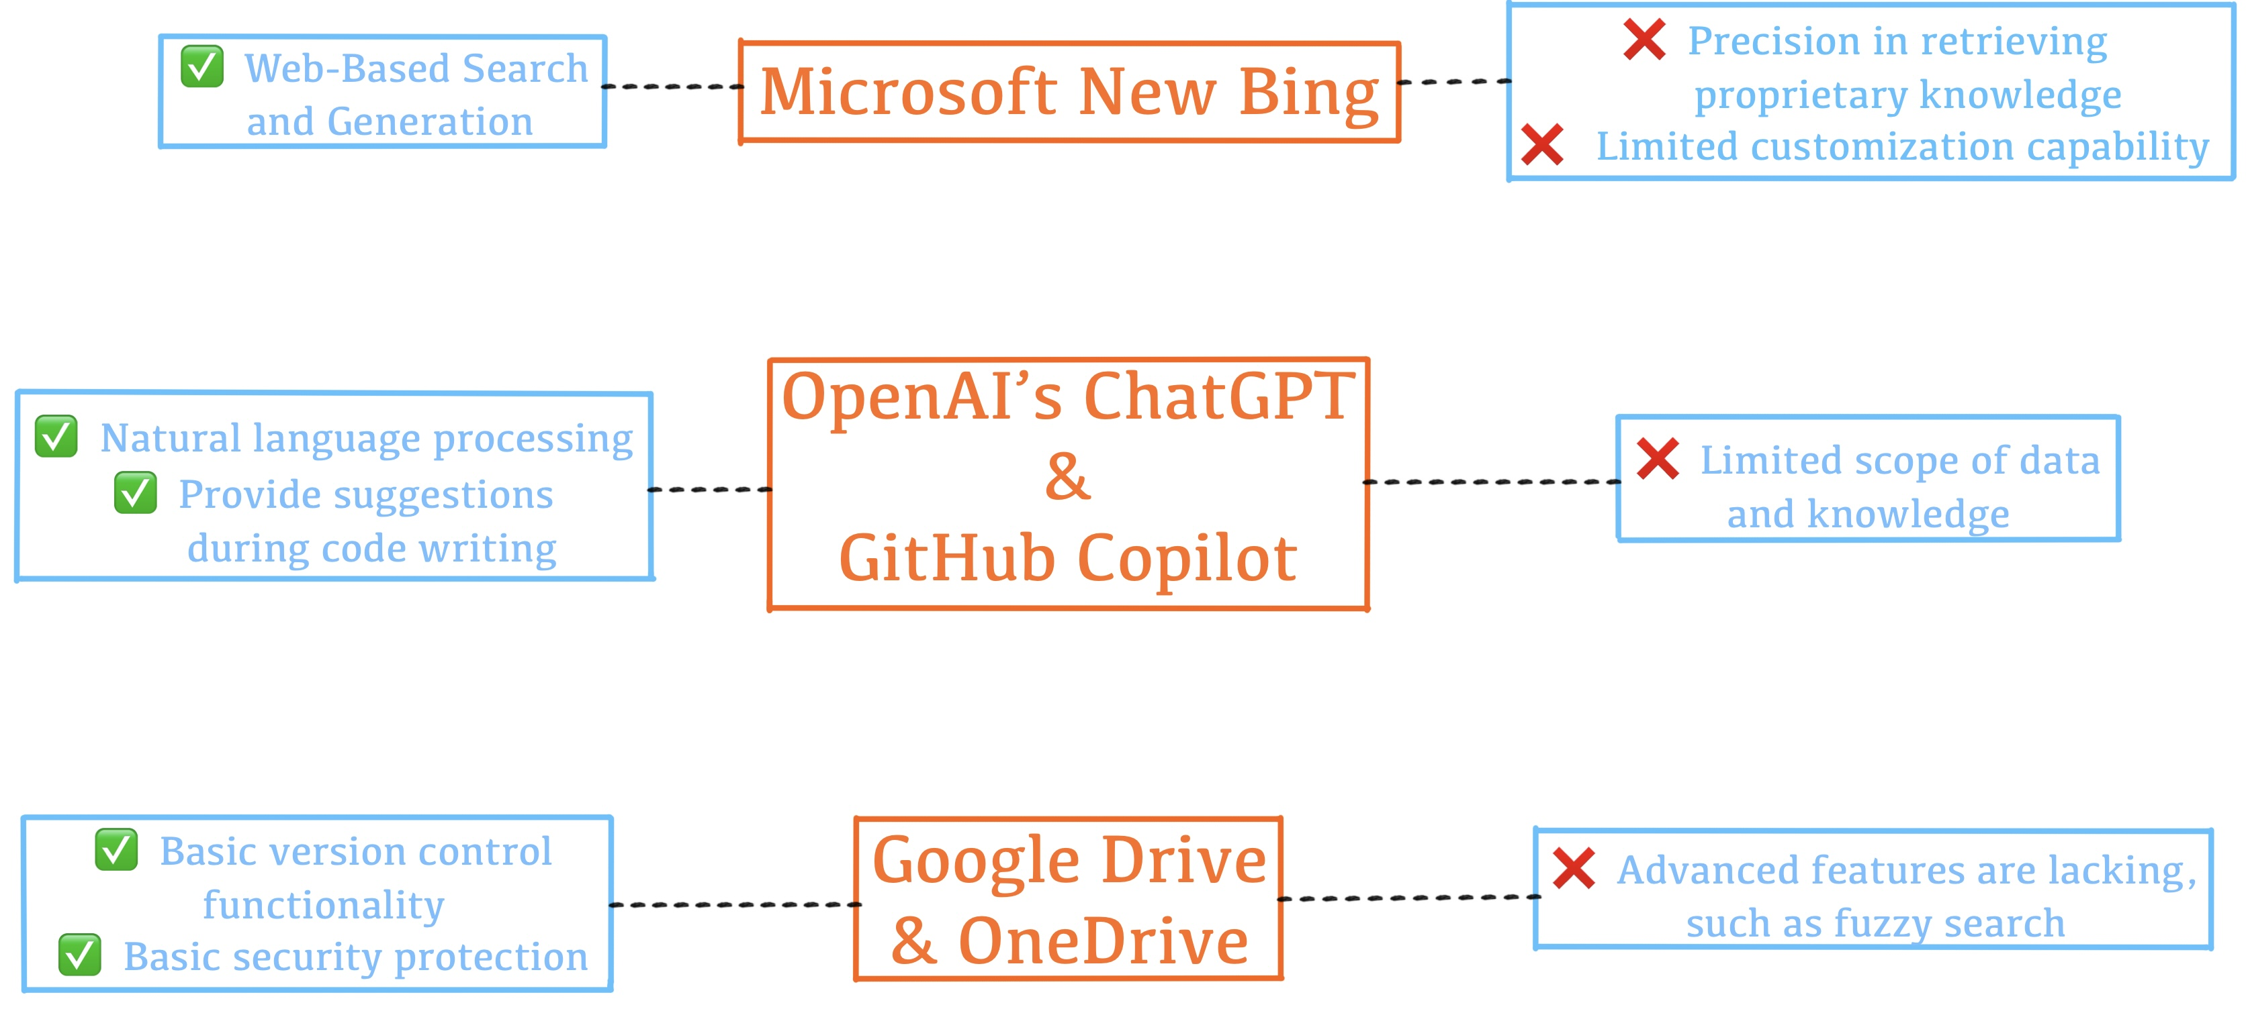
Comparison

Slide 4
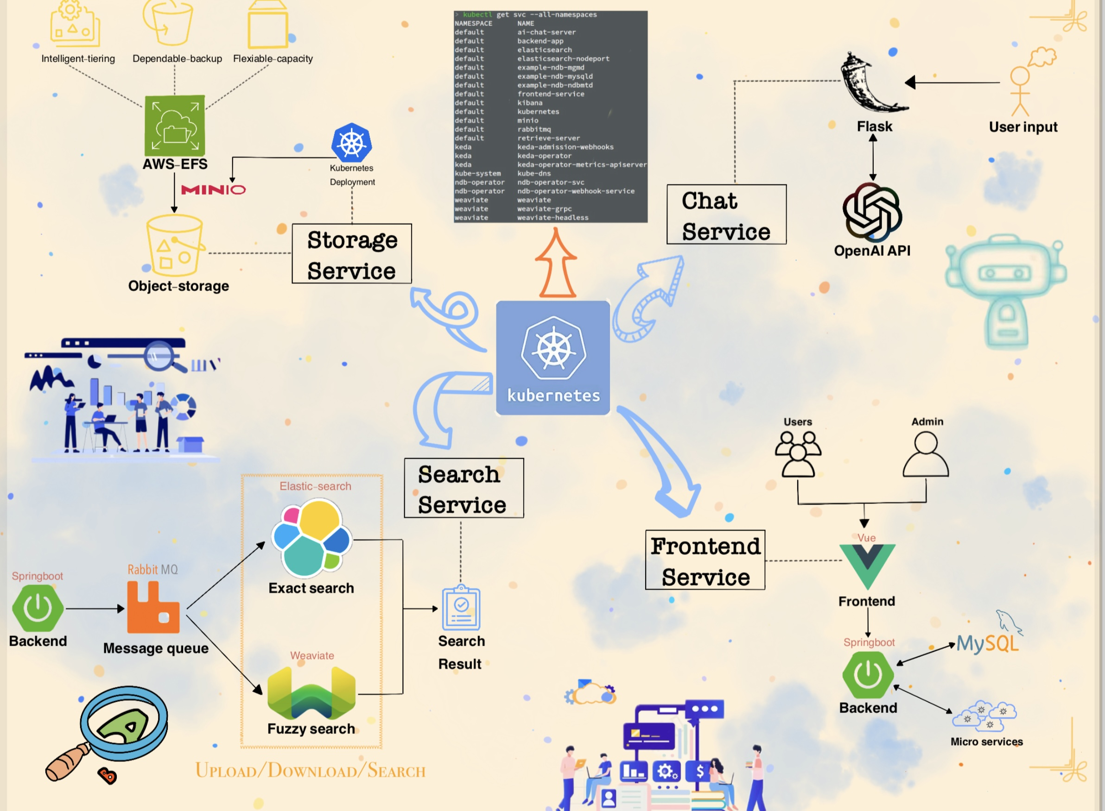
Overview

Slide 5
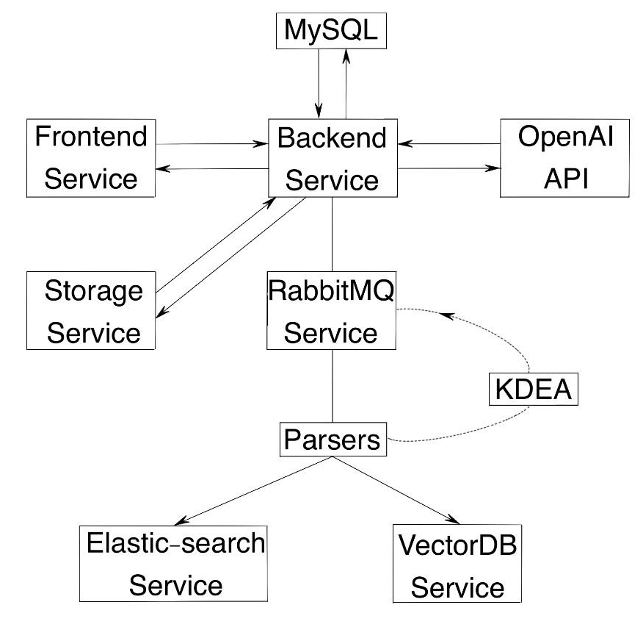



General Architecture

Slide 6
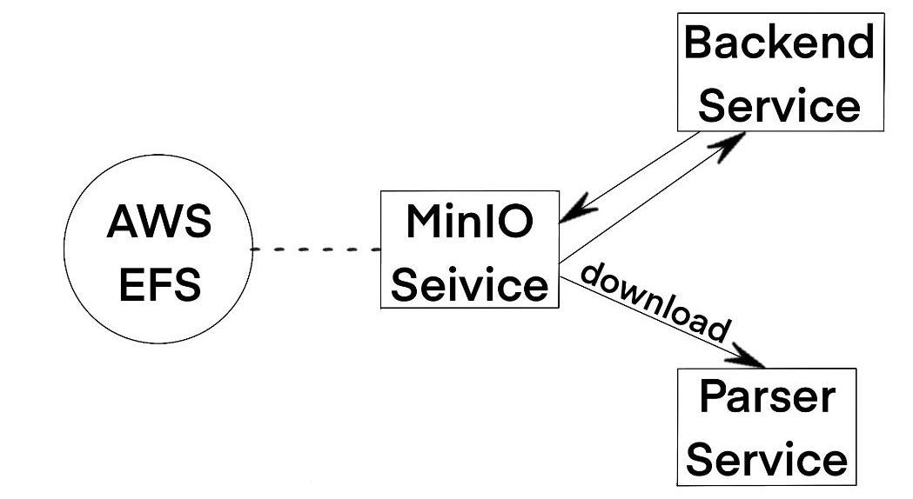
Storage Architecture

Slide 7
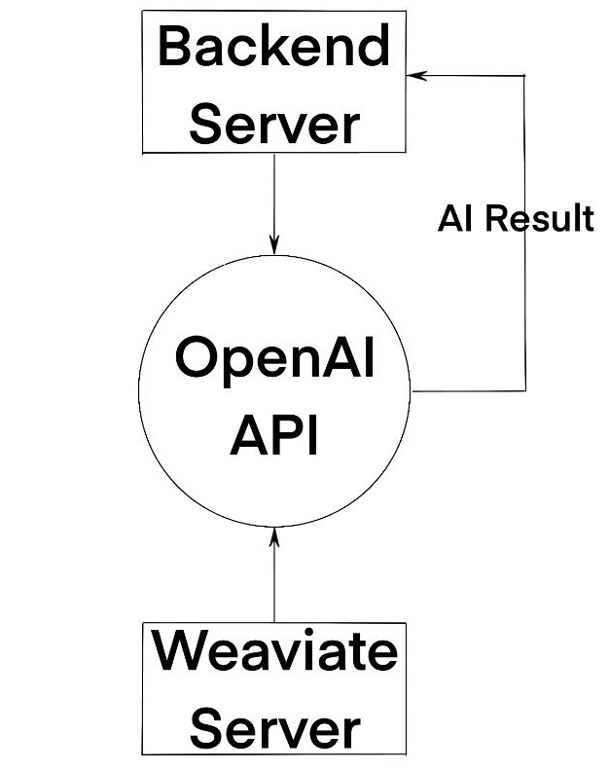
Chat Architecture

Slide 8
KloudMinds
• AI-Powered Document Management
• RAG & Fuzzy Search
• Document Summarization

Slide 9
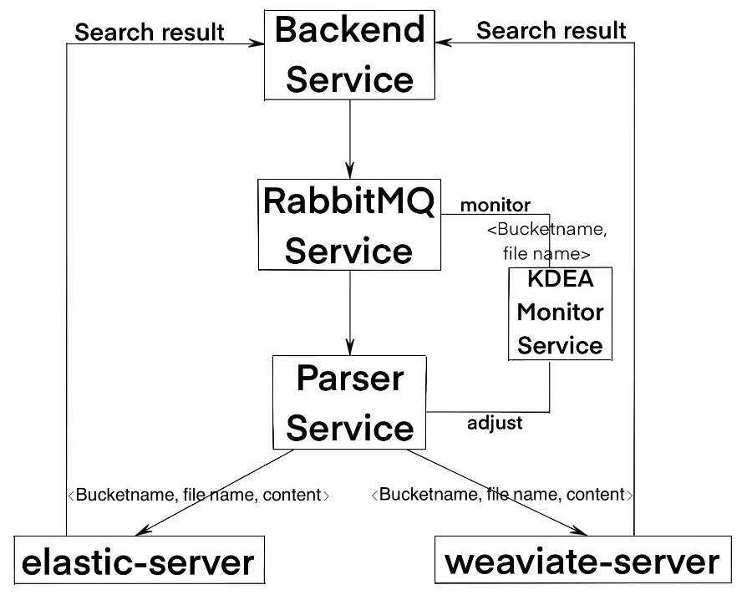
Search Architecture

Slide 10
More...
• Administrator Interface
• Kubernetes System Monitoring
• User Center

Slide 11
DIFFICULTIES

Slide 12
Devoted to cloud native intelligent file system
Thank you for your listening

